Slide 1
PaymentWorks - Onboarding a Supplier
Presented By:
Courtney Baxter (Vendor Data Analyst)
Shayna Houston (Vendor Data Analyst)
Kyra Detwiler (Assistant Director)
Webpage: https://finance.utdallas.edu/buying-goods-services/supplier-management/
Contact Us: vendors@utdallas.edu

Slide 2
PaymentWorks
PaymentWorks is the supplier onboarding system used by the University of Texas at Dallas.
Suppliers will be able to provide documents through the new supplier portal instead of relying on email communications
Suppliers will be able to maintain their own data for updates once setup within PaymentWorks
Campus users will now have visibility to the workflow and setup status within the PaymentWorks portal
Both campus users and suppliers will be able to see invoice information within the new portal
Additional data security is provided by PaymentWorks to ensure our supplier information in accurate and verified
Notes:
1. Suppliers provide documents in portal vs through email
2. Suppliers maintain their own data (updates)
3. Campus users have visibility to workflow (onboarding page/emails)
4. Campus and Vendors view invoice info
5. Additional Security and verification provided by PaymentWorks

Slide 3
Onboarding Process Flow
Notes:
-These are the 6 steps from our webpage that we will be going over each step in detail during the presentation

Slide 4
Onboarding Process Flow - Step #1
The department should check within eProcurement to see if their supplier already exists or is currently inactive.
Notes:
1. Check ePro if supplier exists or is inactive

Slide 5
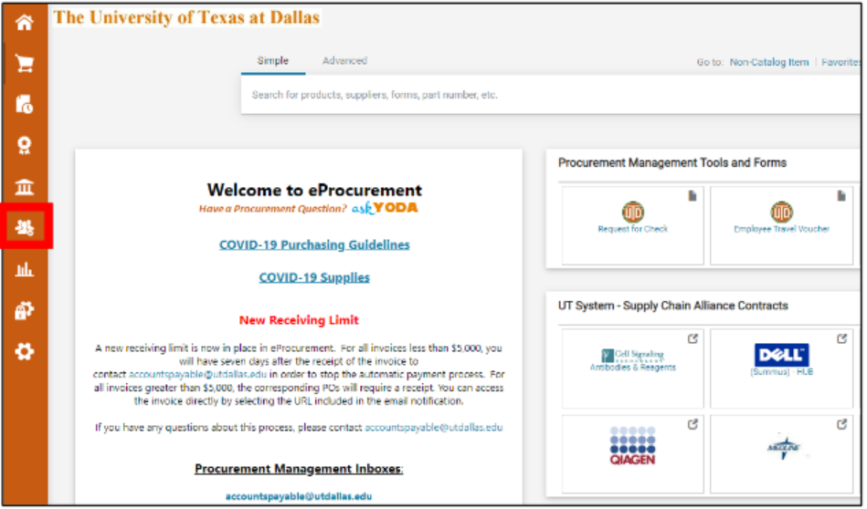
Onboarding Process Flow – Step #1
Log into eProcurement.
Click on the supplier icon on the left navigation bar.
Search for the supplier by supplier name or supplier ID.
NOTE: If searching by supplier ID, you must include the leading zeros to yield a result.
Notes:
Supplier Management Webpage: https://finance.utdallas.edu/buying-goods-services/supplier-management/

Slide 6
Onboarding Process Flow - Step #1
The green check mark indicated a supplier is active and available for use.
The red X indicated a supplier exists within eProcurement but is currently inactive. If the supplier is inactive but does exist, they should email vendors@utdallas.edu so that the reason for inactivation can be determined.
If the supplier is not present, the supplier does not have a profile in our system and should be onboarded for use if needed.
Notes:
-Green check indicates supplier is active an available for use
-Red X indicates supplier exists in ePro but is inactive (email vendors@ for reason)
-Yield no results the suppler does not have a file and needs to be onboarded

Slide 7
Onboarding Process Flow - Step #2
The department submits the appropriate form/requisition in eProcurement with ‘New Vendor Needed’ added as the supplier. ‘New Vendor Needed’ is available for use on all form/requisition types in eProcurement. Please refer to eProcurement Resources for more information on the correct form/requisition to use.
Notes:
eProcurement Resources webpage

Slide 8
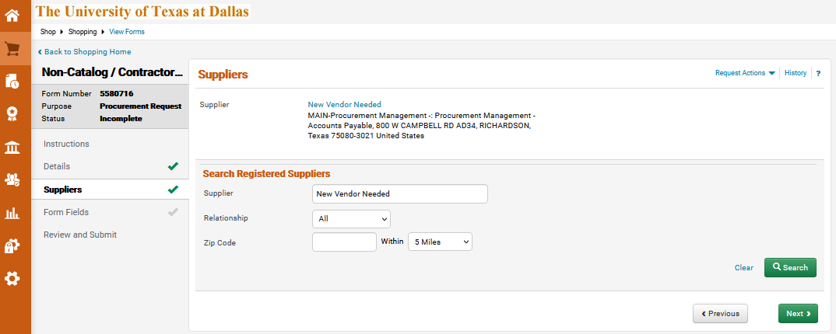
Onboarding Process Flow – Step 2
Notes:
In this example we are showing how to select ‘New Vendor Needed’ as the supplier on a non-catalog requisition

Slide 9
Onboarding Process Flow - Step #3
3. The department exports the requisition into a pdf
document.
Notes:
-note once requisition has been submitted

Slide 10
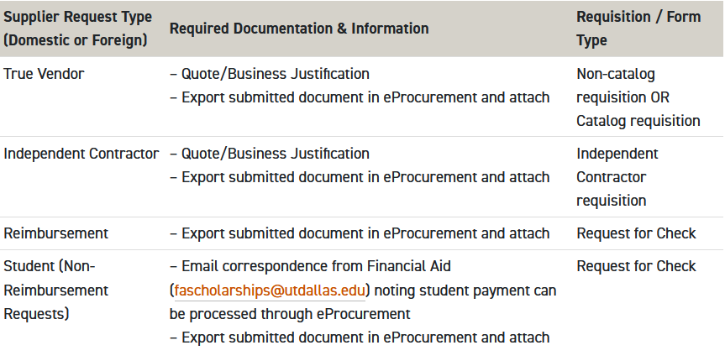
Onboarding Process Flow - Step #4
4. The department submits an invitation in PaymentWorks with
the documents shown in the table below attached.
Note: If you have more than one document, they will need to be merged into one. For instructions on how to merge your documents, please refer to Merge Documents by Combining Files in Acrobat.
Notes:
-PW only accepts 1 document attached to the invitation
-talk to the table

Slide 11
Onboarding Process Flow - Step #4
Gemini for Departments-> External Links-> PaymentWorks
Log into PaymentWorks and select the Vendor Master Updates tile.
Click on the New Vendors Tab.
Notes:
-Login to Galaxy (PS) to locate PW
-link in ePro

Slide 12
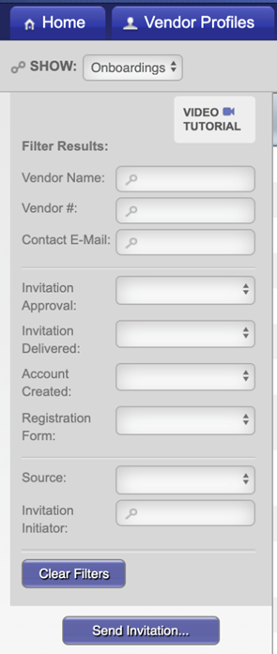
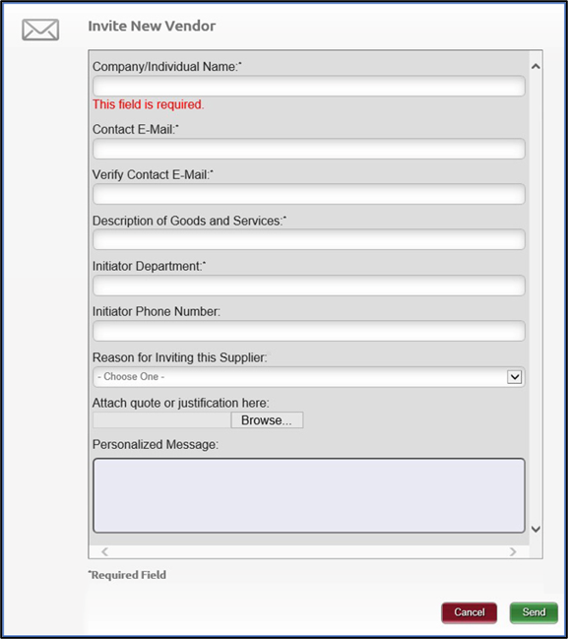
Onboarding Process Flow - Step #4
4. Click on the ‘Send Invitation…’
button.
5. Complete the invitation
Notes:
-Talk to the PW invitation fields and how they should be completed
-phone number, reason for inviting and message not required fields

Slide 13
Onboarding Process Flow - Step #5
5. The department monitors email communications sent
by PaymentWorks to track and facilitate the onboarding
process.

Slide 14
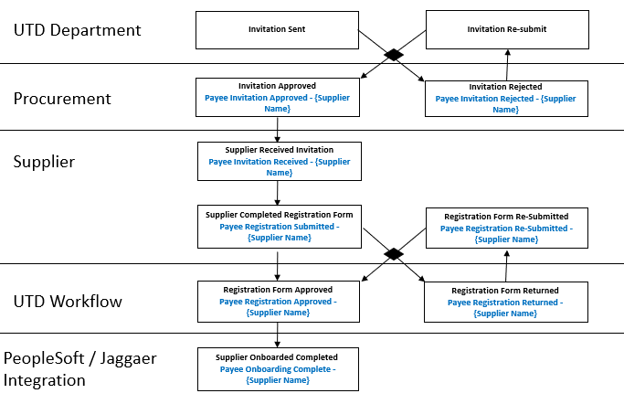
Onboarding Process Flow - Step #5
Notes:
-Black = action / Blue = Email received with action
-Talk to the emails that will be received
-Departments will receive 5 emails (can receive additional emails if invitation was rejected, registration is returned, or resubmitted)

Slide 15
Onboarding Process Flow - Step #6
6. Comment on the submitted requisition noting the
provided vendor ID # sent in the final email
communication from PaymentWorks (Email Title: Payee
Onboarding Complete). Tag the buyer, if assigned to the
requisition, with your comment.
Notes:
-If non-catalog requisition is submitted, ensure to tag the assigned buyer

Slide 16
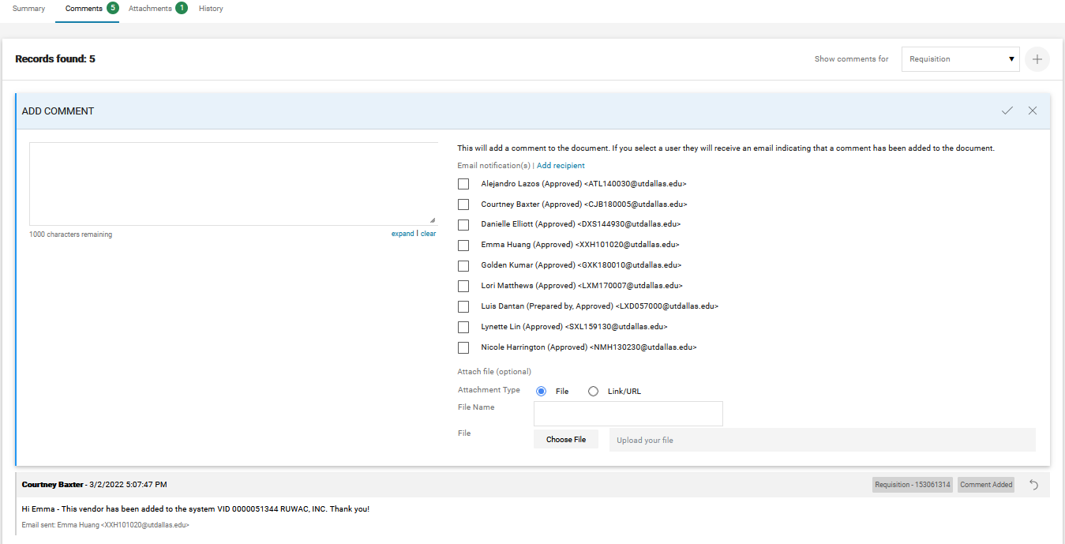
Onboarding Process Flow - Step #6
Notes:
Example of adding comment/how to tag buyer

Slide 17
Onboarding Process Flow
The department should check within eProcurement to see if their supplier already exists or is currently inactive.
The department submits the appropriate form/requisition in eProcurement with ‘New Vendor Needed’ added as the supplier. ‘New Vendor Needed’ is available for use on all form/requisition types in eProcurement. Please refer to eProcurement Resources for more information on the correct form/requisition to use.
The department exports the requisition into a document.
The department submits an invitation in PaymentWorks with the documents shown in the table below attached.
Note: If you have more than one document, they will need to be merged into one. For instructions on how to merge your documents, please refer to Merge Documents by Combining Files in Acrobat.
The department monitors email communications sent by PaymentWorks to track and facilitate the onboarding process.
Comment on the submitted requisition noting the provided vendor ID # sent in the final email communication from PaymentWorks (Email Title: Payee Onboarding Complete). Tag the buyer, if assigned to the requisition, with your comment.
Notes:
Talk to the reasons why for each step:
Ensure the supplier is not already active for use
This helps justify the need for the purchase when the invitation is sent and starts the ePro workflow while onboarding
To connect the requisition with the vendor onboarding
Ensure procurement has the necessary document to review an approve the vendor request
To help facilitate the onboarding process for the purchase to be made
To process the requisition into a PO

Slide 18
Supplier Updates
Existing PaymentWorks Profile
If a supplier already has a connected profile in PaymentWorks, they can log in at any time and make updates to their information.

Slide 19
Supplier Updates
Supplier Not in PaymentWorks
If a supplier has not created a profile in PaymentWorks but is currently an active supplier with UTD (and active in ePro), the respective department should send an invitation to onboard the supplier into ePro.
Sent invitation should note existing vendor ID in description field.
If a supplier has not created a profile in PaymentWorks but is currently an active supplier with UTD (and inactive in ePro), email vendors@utdallas.edu to review.
Notes:
-If the supplier is active in ePro, but not connected in PW department should send invitation.
-attach either the email communication noting the update, or a screenshot of the eProcurement search showing the vendor is inactive

Slide 20
New Feature – Cancel Invitations
Initiators can cancel their PaymentWorks invitations
The Vendor Management team can also cancel invitations on behalf of department initiators
Invitations can be canceled if the registration form has not been submitted by the vendor
Once an invitation is canceled, the vendors email address can be reused for a future invitation
Notes:
-Initiators can cancel invitations
-If needed the VM team can also cancel on behalf of department
-An invitation can be cancelled if the reg form has not been submitted
-emailed can be reused for future invitations

Slide 21
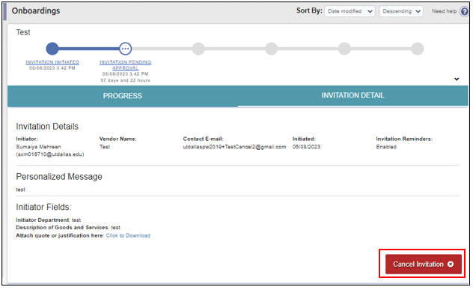
Notes:
-talk to how departments can cancel the invitations

Slide 22
Questions?

