Slide 1
Historically Underutilized Business Subcontracting Plan (Training Presentation)

Slide 2
HUB Program - UTD Commitment
Members of the Supplier Diversity Program work closely with the Purchasing staff and campus stakeholders to promote the use of small minority, woman, and veteran-owned businesses, including the State of Texas Historically Underutilized Business (HUB) supplier.
The University of Texas Dallas is dedicated to promoting opportunities for Historically Underutilized Businesses to compete for University purchases and contracts. The policy is to foster an environment that will enhance participation from such vendors from all areas of the University.

Slide 3
HUB Statutes
Relevant Federal and/or State Statute(s), Board of Regents’ Rule(s), and UTS Policy(ies)
Texas Government Code, Chapter 2155, Purchasing: General Rules and Procedures
Texas Government Code, Chapter 2161, Historically Underutilized Businesses
Texas Administrative Code (TAC) Title 34, Part 1, Chapter 20, Subchapter B, Rule 20.13 Statewide Annual HUB Utilization Goals.20.11-20.28
The University of Texas System Board of Regents’ Rules and Regulations, Rule 20701, Use of Historically Underutilized Businesses
The University of Texas System, Policy UTS137: Historically Underutilized Business (HUB) Program

Slide 4
WHY? It’s the LAW!
TGC §2161 and 34 TAC §20.285
HUB Subcontracting Plan (HSP)
is required for all contracts exceeding $100K in total life value
is required to be submitted per solicitation due date
Will fail review and be rejected if responses are incomplete. This applies HUB responder(s).
Minor deficiencies (failure to sign, date, and submit existing evidence for Good Faith Effort) will be questioned by the HUB team. Vendor will be required to submit all missing information.

Slide 5
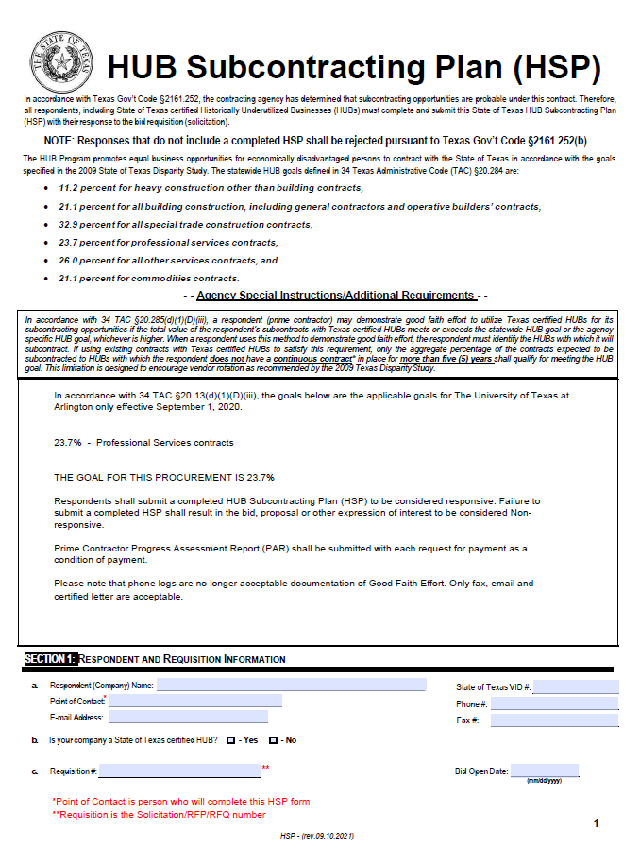
HUB Subcontracting Plan
Section 1: Respondent and Requisition Information
Complete all information requested
Note: Requisition Number is the RFP/ RFQ/Project number and Bid Open Date is the date Proposal is due.
Type in VID # if Texas Corporation
or Tax ID # if no VID # assigned

Slide 6
Selecting the Appropriate HSP
Complete ONLY ONE of the HSP options listed below
Self-Performing
Utilizing Texas HUBs Only
Meeting HUB Goal (HUB & Non-HUB)
Not Meeting HUB Goal
Contract Terms and Conditions
Changes or Expansion of work require HSP revision
Change Orders, Project Addendum and Amendment
Change in Subcontractor
HSP Progress Assessment Report (PAR) shall be submitted with each payment request as a condition of payment

Slide 7
HSP Completion – Self-Performing
If you are not subcontracting any portion of the contract and will be fulfilling the entire contract with your own resources (i.e., equipment, supplies, materials, and/or employees), complete the following in the HSP:
Section 1 – Respondent and Requisition Information
Section 2 a – No, I will not be subcontracting any portion of the contract, and I will be fulfilling the entire contract with my own resources
Section 3 – Self Performing Justification that explains how your company will fulfill the entire contract with its own resources
Section 4 – Affirmation that all information and supporting documentation submitted is true and correct

Slide 8
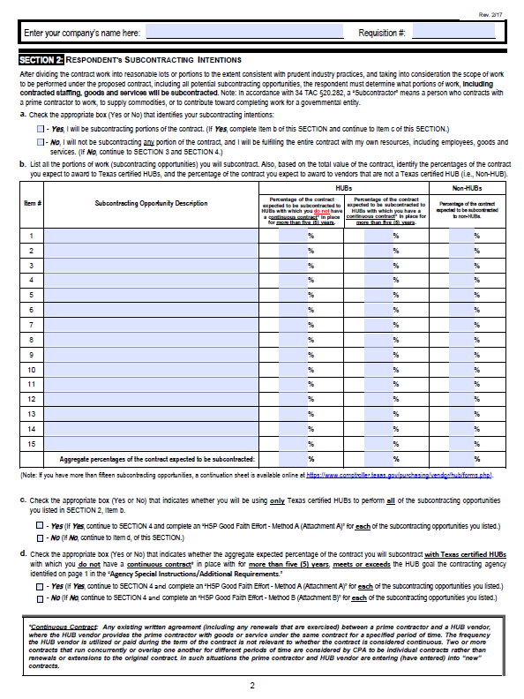
HUB Subcontracting Plan
Self-Performing
Section 2: Respondent’s Subcontracting Intentions
Enter your Company’s name and the Requisition #. (Enter this information on each subsequent page)
2a: x No, I will not be subcontracting any portion of the contract proceed to Section 3

Slide 9
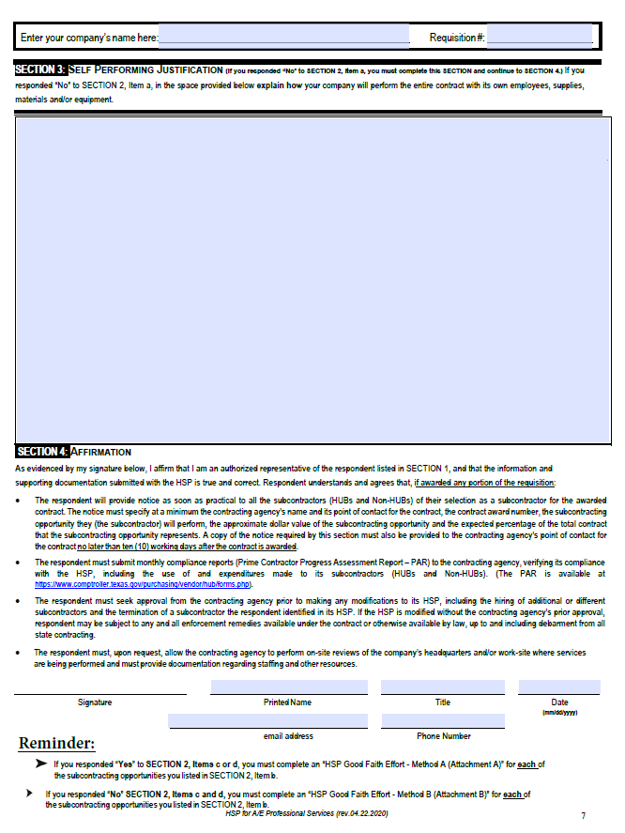
HUB Subcontracting Plan
Self-Performing
Section 3: Self-Performing Justification
In the space provided, explain how your company will perform the entire contract with its own equipment, supplies, materials and/or employees. Suggested verbiage below:
**Section 3 Sample Statement- edit as needed
Company XXX will be fulfilling the entire contract with our own resources, including employees, goods, services, transportation and delivery. If sub-contracting opportunities are identified at a future date, we will immediately contact the project manager and HUB Coordinator and commit to performance of a Good Faith Effort through solicitation of HUB firms and submit an amended HUB Subcontracting Plan.
Section 4: Affirmation
Read, sign and date to affirm information you provided is true and correct

Slide 10
HSP Completion – Utilizing Texas HUBs
If all (100%) of your subcontracting opportunities will be performed using only HUB vendors, complete the following:
Section 1 – Respondent and Requisition Information
Section 2a – Yes, I will be subcontracting portions of the contract
Section 2b – List all the portions of work you will subcontract, and indicate the percentage of the contract you expect to award to HUB vendors (continuation sheet as needed);
Section 2c – Yes, I will be using only Texas certified HUBs to perform all of the subcontracting opportunities listed
Section 4 – Affirmation that all information and supporting documentation submitted is true and correct
HSP Good Faith Effort (GFE) Method A (Attachment A) – Complete this attachment for each subcontracting opportunity listed in Section 2b (Page 1 of 1).

Slide 11
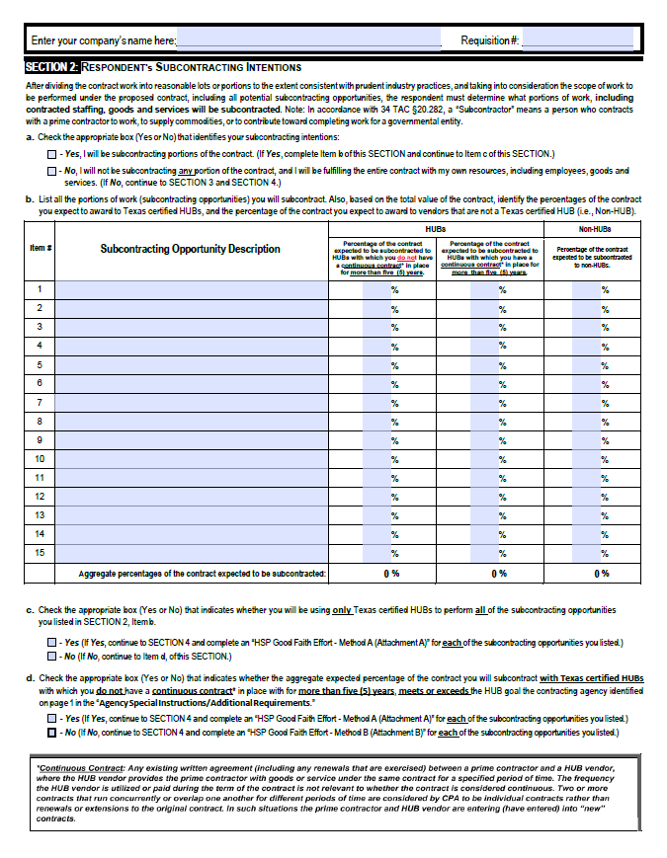
HUB Subcontracting Plan
Subcontracting Texas HUBs Only • GFE Method A
Section 2: Respondent’s Subcontracting Intentions
Don’t put “To Be Determined” (TBD) under Subcontracting Opportunity and Expected Percentage of Contract
Enter your Company’s Name and Requisition #
2a: x Yes, I will be subcontracting any portion of the contract
2b: List all portions of the work you will subcontract with percentages based on the TOTAL value of your proposal
Note: Following page in HSP forms is a continuation sheet should your subcontract opportunities exceed 15
2c: x Yes, Proceed to GFE Method A Form

Slide 12
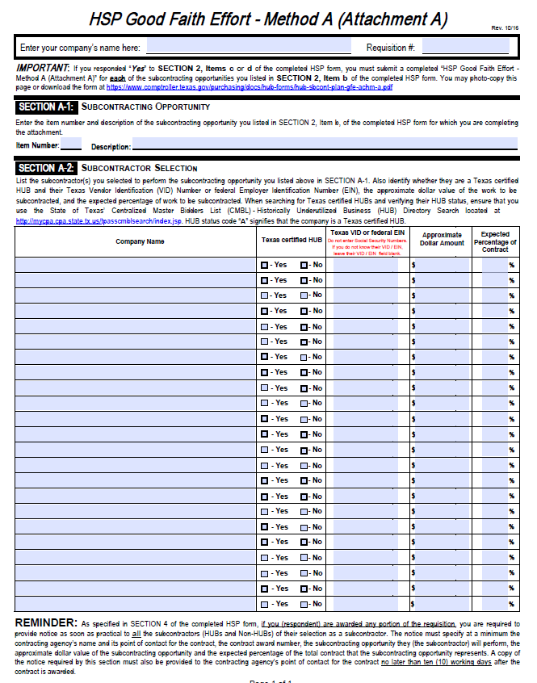
HUB Subcontracting Plan
Subcontracting Texas HUB’s Only • GFE Method A
Section 2: Respondent’s Subcontracting Intentions
Don’t put “To Be Determined” (TBD) under Company Name, Approximate Dollar Amount and Expected Percentage of Contract
A-1: List Item Number and description of opportunity you listed in Section 2
A-2 List HUB company name that will performing this subcontracted portion, check “yes”, then list their Texas VID number, approximate dollar amount and estimated percentage of the ENTIRE proposed contract they will fulfill.
NOTE: Method A sheet must be completed for EACH Subcontracting Opportunity

Slide 13
HSP Completion – Meeting HUB Goal (HUB & Non-HUB)
If you are subcontracting with HUBs and Non-HUBs and you meet or exceed the aggregate percentage (HUB Goal) of subcontracting with HUBs in which you do not have a continuous contract in place for more than five (5) years, complete the following :
Section 1 – Respondent and Requisition Information
Section 2a – Yes, I will be subcontracting portions of the contract
Section 2b – List all the portions of work you will subcontract, and indicate the percentage of the contract you expect to award to HUB vendors (continuation sheet as needed)
Section 2c – No, I will not use only Texas certified HUBs to perform all of the subcontracting opportunities listed
Section 2d – Yes, the aggregate expected percentage of the contract you will subcontract with Texas certified HUBs, which you do NOT have a continuous contract in place for five (5) years or more, meets or exceeds the HUB goal in the solicitation
Section 4 – Affirmation that all information and supporting documentation submitted is true and correct
HSP GFE Method A (Attachment A) – Complete this attachment for each subcontracting opportunity listed in Section 2b (Page 1 of 1).

Slide 14
HUB Subcontracting Plan
Subcontracting HUB & Non-HUB Meet/Exceed Goals • GFE Method A
Section 2: Respondent’s Subcontracting Intentions
Don’t put “To Be Determined” (TBD) under Subcontracting Opportunity and Expected Percentage of Contract
2a: x Yes, I will be subcontracting any portion of the contract
2b: List all portions of the work you will subcontract with percentages based on the TOTAL value of your proposal
Note: Following page in HSP forms is a continuation sheet should your subcontract opportunities exceed 15
2c: x No
2d: x Yes, Proceed to GFE Method A Forms

Slide 15
HUB Subcontracting Plan
Subcontracting HUB & Non-HUB Meet/Exceed Goals • GFE Method A
Don’t put “To Be Determined (TBD) under Company Name, Approximate Dollar Amount and Expected Percentage of Contract
Section 2: Respondent’s Subcontracting Intentions
A-1: List Item Number and description of opportunity you listed in Section 2
A-2 List HUB or Non-HUB company name that will performing this subcontracted portion, check the appropriate box, then list their Texas VID number (or EIN for Non-HUB), approximate dollar amount and estimated percentage of the ENTIRE proposed contract they will fulfill
NOTE: Method A sheet must be completed for EACH Subcontracting Opportunity

Slide 16
HSP Completion – Not Meeting HUB Goal
If you are subcontracting with HUBs and Non-HUBs, and you do not meet or exceed the aggregate percentage (HUB Goal) of subcontracting with HUBs, complete the following:
Section 1 – Respondent and Requisition Information
Section 2a – Yes, I will be subcontracting portions of the contract
Section 2b – List all the portions of work you will subcontract, and indicate the percentage of the contract you expect to award to HUB vendors (continuation sheet as needed);
Section 2c – No, I will not be using only Texas certified HUBs to perform all of the subcontracting opportunities listed Section 2d – No, the aggregate expected percentage of the contract you will subcontract with Texas certified HUBs, which you have a continuous contract in place for five (5) years or less, does not meet or exceed the HUB goal in the solicitation
Section 4 – Affirmation that all information and supporting documentation submitted is true and correct HSP GFE Method B (Attachment B) – Complete this attachment for each subcontracting opportunity (Page 1 of 1).

Slide 17
HUB Subcontracting Plan
Subcontracting Will Not Meet Goals • GFE Method B
Section 2: Respondent’s Subcontracting Intentions
Don’t put “To Be Determined (TBD) under Subcontracting Opportunity and Expected Percentage of Contract
2a: x Yes, I will be subcontracting any portion of the contract
2b: List all portions of the work you will subcontract with percentages based on the TOTAL value of your proposal
Note: Following page in HSP forms is a continuation sheet should your subcontract opportunities exceed 15
2c: x No
2d: x No, Proceed to GFE Method B Forms

Slide 18
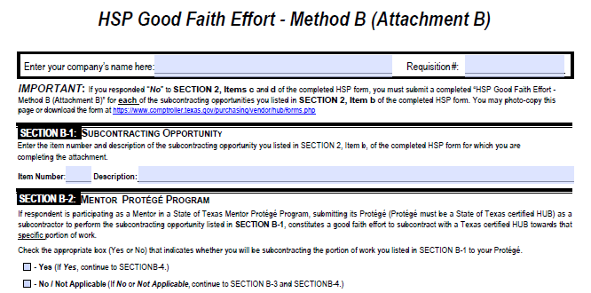
HUB Subcontracting Plan
Subcontracting Will Not Meet Goals • GFE Method B
HSP Good Faith Effort Method B (Attachment B)
B-1: List Item Number and description of subcontracting opportunity listed in Section 2
B-2: If you are using your HUB Protégé, mark yes and continue to Section B-4 GFE Method B form.
If you mark no, continue to Section B-3 and Section B-4 of GFE Method B form.
NOTE: GFE Method B, Section B-1 thru B-4 must be completed for each Subcontract Opportunity identified in HSP Section 2 Respondent's Subcontracting Intentions

Slide 19
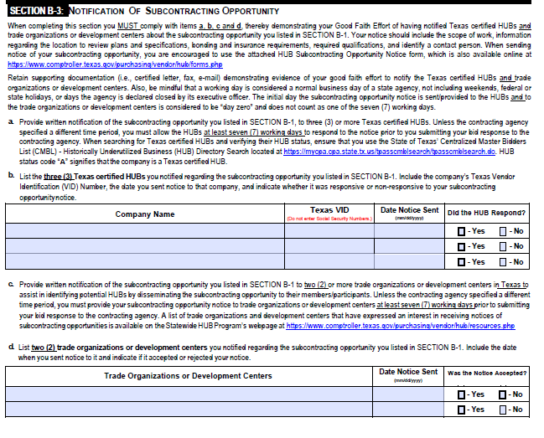
HUB Subcontracting Plan
Subcontracting Will Not Meet Goals • GFE Method B
HSP Good Faith Effort Method B (Attachment B)
B-3: You must comply with items a, b, c and d. Provide documentation (i.e. fax, email, certified letter) demonstrating evidence of your good faith effort. You are encouraged to use the Subcontract Opportunity Notification Form
Allow HUB’s (7) working days to respond. The initial day notice is sent is considered day zero and does not count as one of the (7) days.
List (3) HUB’s contacted* for subcontracting opportunities
Provide subcontracting opportunity notice to trade organizations at least (7) working days prior to submitting your bid response
List (2) Trade Organization contacted for these subcontracting opportunities.

Slide 20
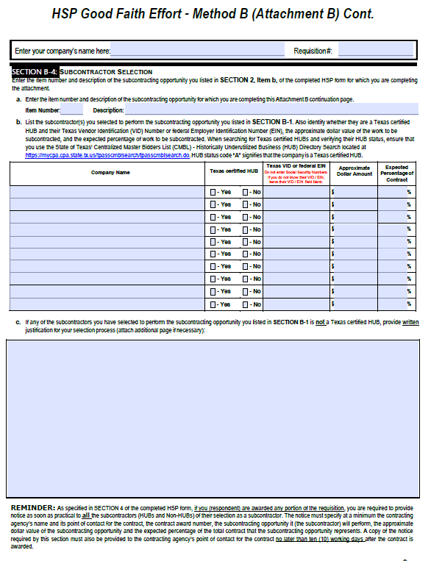
HUB Subcontracting Plan
Subcontracting Will Not Meet Goals • GFE Method B
HSP Good Faith Effort Method B (Attachment B)
Don’t put “To Be Determined (TBD) under Company Name, Approximate Dollar Amount and Expected Percentage of Contract
B-4: Subcontractor Selection
Section A. List Item Number and description of subcontracting opportunity listed in Section 2: Respondents Subcontracting Intentions
Section B. Enter each selected (to be awarded) subcontractor and provide all information in this field.
Section C. Provide written justification as to why a HUB was not selected for this subcontracting opportunity

Slide 21
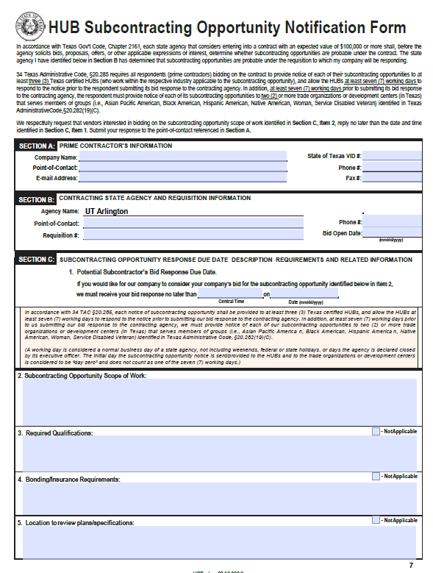
Hub Subcontracting Plan
Subcontracting Will Not Meet Goals • GFE Method B
HSP Subcontracting Opportunity Notification Form
B-4: Subcontractor Selection
Section A – Provide Company contact information. Should be the same as point of contact in HSP
Section B – Provide Agency contact information; RFP/RFQ The point of contact (Not the HUB Coordinator
Section C-1 – Enter Bid Response Due Date and Time
Section C-2.5 Provide information applicable to the subcontracting opportunity to obtain the best responses from solicitate companies

Slide 22
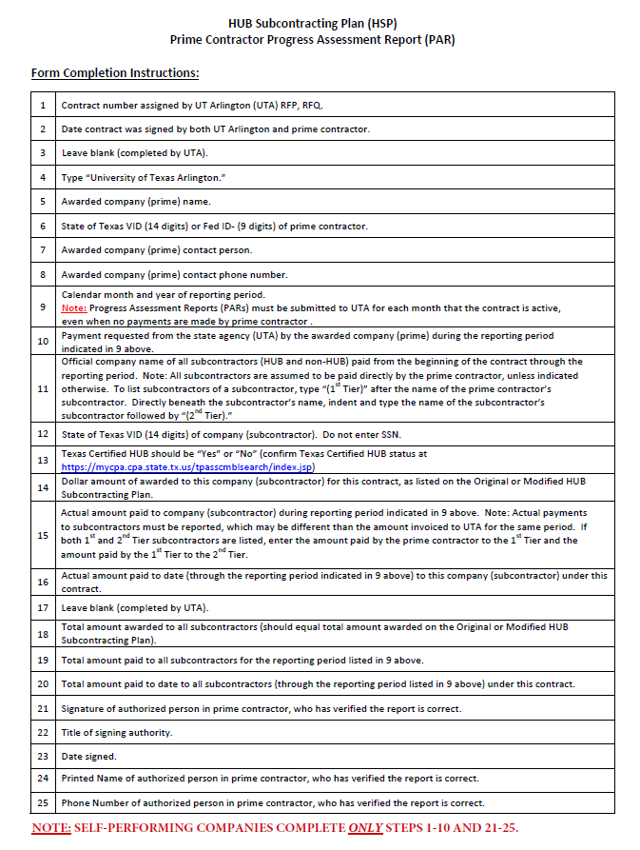
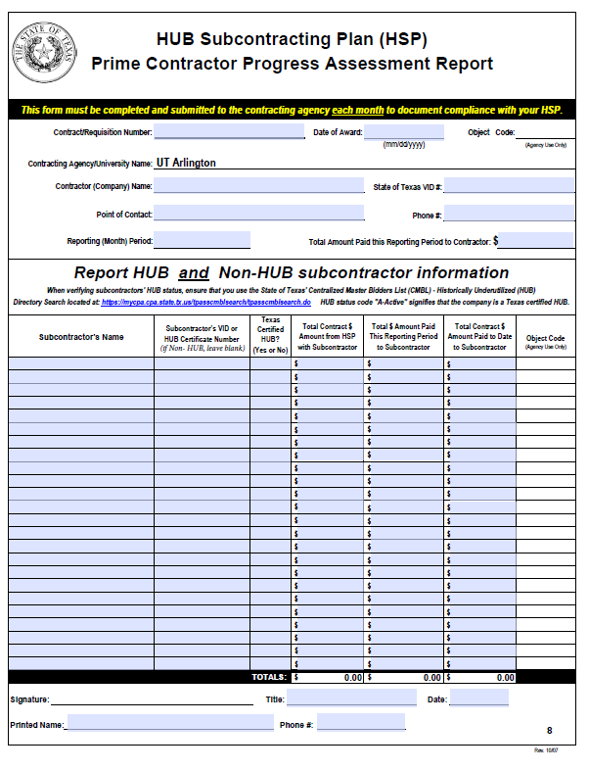
Hub Subcontracting Plan
HUB Subcontracting Progress Assessment Report (PAR)
This form must be completed and submitted to the contracting agency each month to document compliance with your HSP.
PAR form with Instructions will be provided during Post Award Meeting
Instructions
PAR shall be submitted with each request for payment as a condition of payment.

Slide 23
The University of Texas at Dallas
HUB Point of Contact
A preliminary review of proposed HSPs by the HUB Team is highly recommended to address possible deficiencies prior to bid submission. Responders are advised to submit their HSP for review at least 10 days prior to due date.
Submit review via email hub@utdallas.edu

Slide 24
Thank You

