Slide 1
Updating the FY22 Accounting Date and Fiscal Year Budget Fields in eProcurement

Slide 2
FY22 Requisitions
Departments can begin submitting requisitions on 8/2/21 for purchases to be received after 9/1/21 and charged to FY22 budgets.
To ensure that costs are charged to FY22 budgets, assign FY22 values to both the Accounting Date and Fiscal Year Budget
Set the Accounting Date to 9/1/21 and the Fiscal Year Budget to FY22.
Requisitions that are submitted with an Accounting Date in FY21 but specify an FY22 Budget will need to be withdrawn.

Slide 3
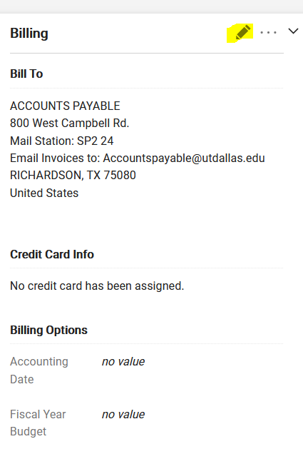
Required FY22 Entries
After creating your cart, click on “Proceed to Checkout” to complete your draft requisition.
Click on the pencil icon on the ‘Billing’ section of the requisition to access the “Edit Billing” dialogue box and the 2 fields that need to be updated.

Slide 4
Updating the FY22 Accounting Date and Budget Fields
Scroll down to the bottom of the “Edit Billing” dialogue box.
Click on the calendar icon next to the Accounting Date field and select 9/1/21.
Click on the dropdown arrow by the Fiscal Year Budget field and select FY22.
The screenshot on the next page illustrates the entries.
Save changes.
After submitting your requisition, check to ensure that the Accounting Date and Fiscal Year Budget fields reflect the correct values to charge FY22 budgets.

Slide 5
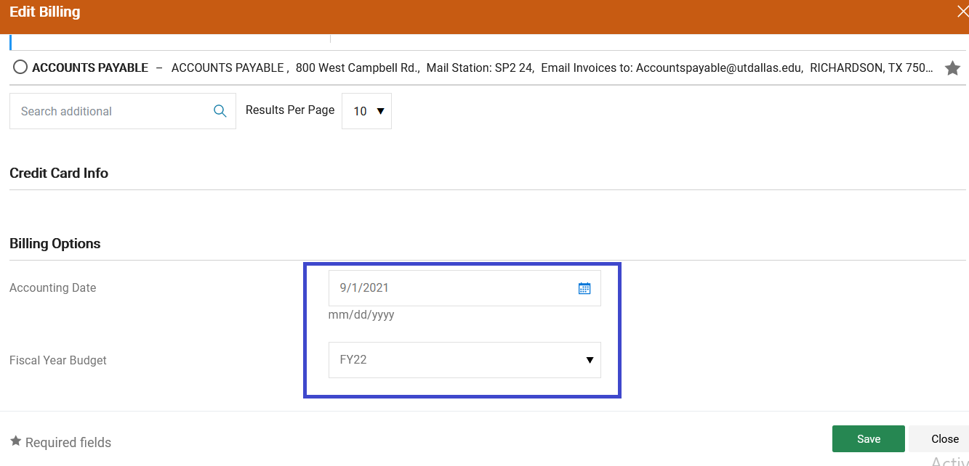

Slide 6
Thank you!
Contact Purchasing@utdallas.edu if you have questions.

